Slide 1
COMP6049 – Algorithm Design and Analysis
Topic 10-11 – Greedy methods

Slide 2
Outline Materials
Greedy method list
Fractional Knapsack problem list
Disjoint Set data structure
Minimum spanning tree
Shortest path

Slide 3
SOLUTION OF PROBLEMS
One of the functions of the algorithm is to solve problems/issues.
A problem could be:
Having a single set of solutions
Having multiple sets of solutions that are equally true
Having multiple sets of solutions with different levels of truth
Do not have a set of solutions that "total" true, but there are several sets of solutions close to the truth
Do not have the set of solutions at all

Slide 4
PROBLEM SOLVING TECHNIQUES
Some of the popular techniques in problem solving:
Greedy method
Dynamic Programming
Data compression
Backtracking
Branch and Bound

Slide 5
GREEDY METHOD
Greedy means rapacious = “serakah”.
Algorithms often perform some calculation phase before finding a final solution.
Sometimes these stages produced a number of elements that will be used to formulate the final solution.
Greedy method will "ignore" a complete calculation in the search for solutions, replacing it with using those elements to calculate the solution more quickly.
Very useful if the search for solutions 100% take too long rather than waste time trying to calculate the "best" solution, it is better saved by finding a "good enough" solution.

Slide 6
UNIVERSAL SOLUTION
A problem has:
Universal solution
all the possible solutions both right and wrong
Feasible solution
all possible correct solutions, but different levels of truth
Objective function
the function to measure the solution which is more correct (better)
Optimal solution
the most correct solution (best)

Slide 7
KNAPSACK PROBLEM
A thief entered a house. He was carrying a bag with maximum capacity 20 kg. At the house there are items A, B, C, D, E.
A weighed 7 kg, valued at $ 2975
B weighed 3 kg, valued at $ 1230
C weighed 9 kg, valued at $ 3870
D weighed 2 kg, valued at $ 840
E weighed 5 kg, valued at $ 2250
What items to bring the thief for getting maximum benefit? (must not exceed the capacity of his bag of 20 kg)

Slide 8
VARIATION OF KNAPSACK PROBLEM
Fractional Knapsack Problem
Items should be brought in part (in fractional units).
0/1 Knapsack Problem
Each item is only available 1 unit, take it or leave it.
Bounded Knapsack Problem
Each item is available in N units (limited number).
Unbounded Knapsack Problem
Each item is available in more than one unit, the number is unlimited.

Slide 9
CALCULATION FEASIBLE SOLUTION
If the above example is the case of 0/1 Knapsack, its feasible solutions:
Item | Weight | Value |  | Item | Weight | Value
{} | 0 | 0 |  | {A,B,C} | 19 | 8075
{A} | 7 | 2975 |  | {A,B,D} | 12 | 5045
{B} | 3 | 1230 |  | {A,B,E} | 15 | 6455
{C} | 9 | 3870 |  | {A,C,D} | 18 | 7685
{D} | 2 | 840 |  | {A,C,E} | 21 | 9095
{E} | 5 | 2250 |  | {A,D,E} | 14 | 6065
{A,B} | 10 | 4205 |  | {B,C,D} | 14 | 5940
{A,C} | 16 | 6845 |  | {B,C,E} | 17 | 7350
{A,D} | 9 | 3815 |  | {B,D,E} | 10 | 4320
{A,E} | 12 | 5225 |  | {C,D,E} | 16 | 6960
{B,C} | 12 | 5100 |  | {A,B,C,D} | 21 | 8915
{B,D} | 5 | 2070 |  | {A,B,C,E} | 24 | 10325
{B,E} | 8 | 3480 |  | {A,B,D,E} | 17 | 7295
{C,D} | 11 | 4710 |  | {A,C,D,E} | 23 | 9935
{C,E} | 14 | 6120 |  | {B,C,D,E} | 19 | 8190
{D,E} | 7 | 3090 |  | {A,B,C,D,E} | 27 | 11165

Slide 10
SOLUTION
0/1 Knapsack Problem
Can not be solved by Greedy Method
Why?
Unbounded Knapsack Problem
Can be solved by Greedy Method.
Calculate the value per kg.
Take the highest value.
Take the item with the highest value as much as possible (note the limit on the weight and the amount of availability of goods).
If there are remaining weight, use of goods with the highest value and so on.
Calculate the complexity of the algorithm!
Fractional Unbounded Knapsack Problem
Can be solved by Greedy Method
Calculate the value per kg.
Take the highest value.
Enter the item with the highest value as much as possible (note the limit on the weight and the amount of availability of goods).
Calculate the complexity of the algorithm!

Slide 11
UNBOUNDED KNAPSACK PROBLEM (1)
Step 1: calculate the value per kg
Item A weighing 7 kg, value $2,975 → value per kg = $425
Item B weighing 3 kg, value $1230 → value per kg = $410
Item C weighing 9 kg, value $3,870 → value per kg = $430
Item D weighing 2 kg, value $840 → value per kg = $420
Item E weighing 5 kg, value $2250 → value per kg = $450
Step 2: take the highest value
The highest value is $ 450 per kg, mean item E will be taken.
Step 3: Take the item with the highest value as much as possible
Maximum weight that can be taken is 20 kg, item E are very large (unlimited), means that the thief was able to bring home 4 pieces of item E. The gains is 4 x 2250 = $ 9000
Step 4: if there is residual weight, take the item with second highest value and so on.
In the above case, there is no rest for 4 pieces of heavy item E already has a total weight of 20 kg, equal to the maximum weight limit.

Slide 12
UNBOUNDED KNAPSACK PROBLEM (2)
If maximum weight is changed to 23 kg
Step 1: calculate the value per kg
Item A weighing 7 kg, value $2,975 → value per kg = $425
Item B weighing 3 kg, value $1230 → value per kg = $410
Item C weighing 9 kg, value $3,870 → value per kg = $430
Item D weighing 2 kg, value $840 → value per kg = $420
Item E weighing 5 kg, value $2250 → value per kg = $450
Step 2: take the highest value
The highest value is $ 450 per kg, mean item E will be taken.
Step 3: Take the item with the highest value as much as possible
Maximum weight that can be taken is 20 kg, item E are very large (unlimited), means that the thief was able to bring home 4 pieces of item E. The gains is 4 x 2250 = $ 9000
Step 4: if there is residual weight, take the item with second highest value and so on.
Item C (the second highest value) can not be taken due to exceeding the weight limit
Item A (the third highest value) can not be taken due to exceeding the weight limit
Item D (the fourth highest value) were taken in increments of 1 pieces, total weight is now 22 kg
The remaining weight of 1 kg, there are no other items that can be brought
4 items E and 1 D of goods worth $ 9,420
If the thief was carrying four E and a B, he can earn $ 10,320 → Greedy method is not optimal

Slide 13
FRACTIONAL KNAPSACK PROBLEM
Maximum weight 23 kg
Step 1: calculate the value per kg
Item A weighing 7 kg, value $2,975 → value per kg = $425
Item B weighing 3 kg, value $1230 → value per kg = $410
Item C weighing 9 kg, value $3,870 → value per kg = $430
Item D weighing 2 kg, value $840 → value per kg = $420
Item E weighing 5 kg, value $2250 → value per kg = $450
Step 2: take the highest value
The highest value is $ 450 per kg, mean item E will be taken
Step 3: take the item with the highest value as much as possible
Maximum weight that can be taken is 23 kg, item E is available in a number of denominations, meaning the thief can bring home the goods 4.6 E. The advantage obtained is 4.6 x 2250 = $ 10,350
This solution the Greedy method produces an optimal solution!

Slide 14
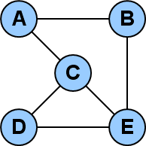
GRAPH vs TREE
A tree can be described as a specialized case of graph with no self loops and circuits.
There are no loops in a tree whereas a graph can have loops.
There are three sets in a graph i.e. edges, vertices and a set that represents their relation while a tree consists of nodes that are connected to each other. These connections are referred to as edges.
In tree there are numerous rules spelling out how connections of nodes can occur whereas graph has no rules dictating the connection among the nodes.

Slide 15
Disjoint Sets
A disjoint-set data structure is a data structure that keeps track of a set of elements partitioned into a number of disjoint (non-overlapping) subsets
This data structure also called “union-find data structure” or “merge-find set” or “union-find disjoin-set data structure”.
It provides near-constant-time operations to add new set, to merge existing sets, and to determine whether elements are in the same set.
This data structure plays a key role in KRUSKAL’S ALGORITHM for finding the minimum spanning tree of a graph. It’s used to find the “loop” in the algorithm process when considering an edge will be taken or not.

Slide 16
Disjoint Sets
A disjoint-set data structure consists of a number of elements each of which stores an id, a pointer to its parent, and in an efficient version of this data structure, a value called “rank” (we won’t discuss this)
The pointer to its parent are arranged to form one or more trees.
A set may consist only a single element. However, if the element has a parent, the element is part of whatever set is identified by following the chain of parents upwards until a representative element (one without a parent) is reached at the root of the tree
Disjoint set can be implemented using array which parents are indicated by their array index.

Slide 17
Disjoint Sets
Disjoint Set Has 3 Operations:
MakeSet(n)
The MakeSet operation create n new sets creating n new element with each of the elements has a unique id, and a pointer that points to itself. The pointer that points to itself indicates that the element is the representative member of its own set.
FindSet(x)
The Find operation follow the chain of pointer to parent from X upwards through the tree until an element is reached whose the parent is itself. This element is the root of the tree and is the representative member of the set to which X belongs, and may be X itself.
Union(a,b) The Union uses Find operation to determine the roots of trees a and b belong to. If the roots are distinct/different, the trees are combined by attaching the root of one to the root of the other. If this is done naively, such as by always making X a child of Y, the height of the trees can grow as O(n). To prevent this, several strategy needs to be used.

Slide 18
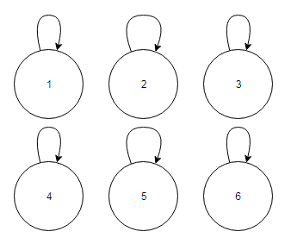
Disjoint Sets
MakeSet(6)

Slide 19
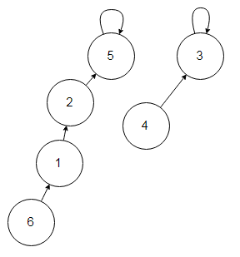
Disjoint Sets
Find(6) = 5
Find(4) = 3
Find(2) = 5
Find(1) = 5
Find(5) = 5
Find(3) = 3

Slide 20
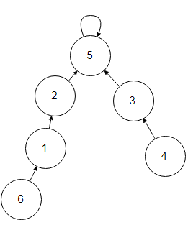
Disjoint Sets
Union(1,4):
Find(1) = 5
Find(4) = 3
Make Node 3 point to a new parent node 5.

Slide 21
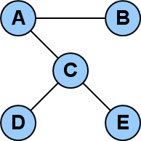
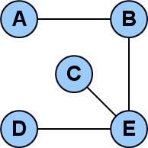
SPANNING TREE
Spanning Tree is a Tree that created from Graph by eliminating some its edge. This tree should contain all the nodes owned Graph.

Slide 22
MINIMUM SPANNING TREE
A single graph can have many different spanning trees.
If a Weighted Graph is changed to Spanning Tree, every combination of the Tree can be created to have sum of different weight.
Problem in Minimum Spanning Tree (MST) is to get tree (as from a Weighted Graph) with minimum sum of the weight.

Slide 23
MST USING METODE GREEDY
Prim-Dijkstra algorithm
was invented by Robert C. Prim in 1957 and Edsger Dijkstra in 1959.
Kruskal algorithm
was invented by Joseph Kruskal in 1956.

Slide 24
MST – Prim’s Algorithm
Prim's algorithm:
let Array T initialize as null
while (T has fewer than n vertices)
{
find the smallest edge connecting T to G-T
add it to T
}

Slide 25
MST – Prim’s Algorithm
Prim's algorithm:
Explanation :
1. Create an array with name is T.
2. Choose starting vertex.
3. Whenever each vertex is pointed, the edge which connected to it will be signed as active.
4. Compare all the active edges value, find the smallest number.
5. Add the node with smallest active edge to T.
6. Do step 3 to 5 while the node in T is fewer the total node exist.

Slide 26
MST – Prim’s Algorithm
Prim's algorithm with Heap Implementation:
T = {s}
enqueue edges connected to s in PQ (by inc weight)
while (!PQ.isEmpty)
if (vertex v linked with e=PQ.remove is not in T)
T = T ∪ {v,e}, enqueue edges connected to v
else
ignore e
Notes:
Heap is implementation of priority queue.

Slide 27
MST – Prim’s Algorithm
Simulation :
Transform the graph below into MST form using Prim’s Algorithm!
B
3
D
2
1
A
5
2
1
4
C
E
2
4
3
1
F

Slide 28
MST – Prim’s Algorithm
Simulation :
Adjacency List
A – C (1)
A – B (2)
A – F (4)
B – C (5)
B – D (3)
B – E (4)
B – F (4)
C – D (1)
C – E (2)
C – F (3)
D – E (2)
E – F (1)
PQ
NULL
T
NULL
V
B
3
D
2
1
A
5
2
1
4
C
E
2
4
3
1
F
Notes:
In this example the T will be shown the track, the V will be shown the MST. To make student easier to understand the concept.
The actual algorithm will only focusing on T, and the remains value will define the MST form. So, the process either insert or remove will only focusing on T and remaining items will shown the MST form.

Slide 29
MST – Prim’s Algorithm
Simulation :
Adjacency List
A – C (1)
A – B (2)
A – F (4)
B – C (5)
B – D (3)
B – E (4)
C – D (1)
C – E (2)
C – F (3)
D – E (2)
E – F (1)
PQ
A – C (1)
A – B (2)
A – F (4)
T
NULL
V
A
B
3
D
2
1
A
5
2
1
4
C
E
2
4
3
1
F
Notes:
In this example the T will be shown the track, the V will be shown the MST. To make student easier to understand the concept.
The actual algorithm will only focusing on T, and the remains value will define the MST form. So, the process either insert or remove will only focusing on T and remaining items will shown the MST form.

Slide 30
MST – Prim’s Algorithm
Simulation :
Adjacency List
A – C (1)
A – B (2)
A – F (4)
B – C (5)
B – D (3)
B – E (4)
C – D (1)
C – E (2)
C – F (3)
D – E (2)
E – F (1)
PQ
A – C (1)
C – D (1)
A – B (2)
C – E (2)
C – F (3)
A – F (4)
B – C (5)
T
NULL
A – C (1)
V
A
C
B
3
D
2
1
A
5
2
1
4
C
E
2
4
3
1
F
Notes:
In this example the T will be shown the track, the V will be shown the MST. To make student easier to understand the concept.
The actual algorithm will only focusing on T, and the remains value will define the MST form. So, the process either insert or remove will only focusing on T and remaining items will shown the MST form.

Slide 31
MST – Prim’s Algorithm
Simulation :
Adjacency List
A – C (1)
A – B (2)
A – F (4)
B – C (5)
B – D (3)
B – E (4)
C – D (1)
C – E (2)
C – F (3)
D – E (2)
E – F (1)
PQ
A – C (1)
C – D (1)
A – B (2)
C – E (2)
D – E (2)
C – F (3)
B – D (3)
A – F (4)
B – C (5)
T
NULL
A – C (1)
C – D (1)
V
A
C
D
B
3
D
2
1
A
5
2
1
4
C
E
2
4
3
1
F
Notes:
In this example the T will be shown the track, the V will be shown the MST. To make student easier to understand the concept.
The actual algorithm will only focusing on T, and the remains value will define the MST form. So, the process either insert or remove will only focusing on T and remaining items will shown the MST form.

Slide 32
MST – Prim’s Algorithm
Simulation :
Adjacency List
A – C (1)
A – B (2)
A – F (4)
B – C (5)
B – D (3)
B – E (4)
C – D (1)
C – E (2)
C – F (3)
D – E (2)
E – F (1)
PQ
A – C (1)
C – D (1)
A – B (2)
C – E (2)
D – E (2)
C – F (3)
B – D (3)
A – F (4)
B – E (4)
B – C (5)
T
NULL
A – C (1)
C – D (1)
A – B (2)
V
A
C
D
B
B
3
D
2
1
A
5
2
1
4
C
E
2
4
3
1
F
Notes:
In this example the T will be shown the track, the V will be shown the MST. To make student easier to understand the concept.
The actual algorithm will only focusing on T, and the remains value will define the MST form. So, the process either insert or remove will only focusing on T and remaining items will shown the MST form.

Slide 33
MST – Prim’s Algorithm
Simulation :
Adjacency List
A – C (1)
A – B (2)
A – F (4)
B – C (5)
B – D (3)
B – E (4)
C – D (1)
C – E (2)
C – F (3)
D – E (2)
E – F (1)
PQ
A – C (1)
C – D (1)
E – F (1)
A – B (2)
C – E (2)
D – E (2)
C – F (3)
B – D (3)
A – F (4)
B – E (4)
B – C (5)
T
NULL
A – C (1)
C – D (1)
A – B (2)
C – E (2)
V
A
C
D
B
E
B
3
D
2
1
A
5
2
1
4
C
E
2
4
3
1
F
Notes:
In this example the T will be shown the track, the V will be shown the MST. To make student easier to understand the concept.
The actual algorithm will only focusing on T, and the remains value will define the MST form. So, the process either insert or remove will only focusing on T and remaining items will shown the MST form.

Slide 34
MST – Prim’s Algorithm
Simulation :
Adjacency List
A – C (1)
A – B (2)
A – F (4)
B – C (5)
B – D (3)
B – E (4)
C – D (1)
C – E (2)
C – F (3)
D – E (2)
E – F (1)
PQ
A – C (1)
C – D (1)
E – F (1)
A – B (2)
C – E (2)
D – E (2)
C – F (3)
B – D (3)
A – F (4)
B – E (4)
B – C (5)
T
NULL
A – C (1)
C – D (1)
A – B (2)
C – E (2)
E – F (1)
V
A
C
D
B
E
F
B
3
D
2
1
A
5
2
1
4
C
E
2
4
3
1
F
Notes:
In this example the T will be shown the track, the V will be shown the MST. To make student easier to understand the concept.
The actual algorithm will only focusing on T, and the remains value will define the MST form. So, the process either insert or remove will only focusing on T and remaining items will shown the MST form.

Slide 35
MST – Prim’s Algorithm
Simulation :
Adjacency List
A – C (1)
A – B (2)
A – F (4)
B – C (5)
B – D (3)
B – E (4)
C – D (1)
C – E (2)
C – F (3)
D – E (2)
E – F (1)
PQ
A – C (1)
C – D (1)
E – F (1)
A – B (2)
C – E (2)
D – E (2)
C – F (3)
B – D (3)
A – F (4)
B – E (4)
B – C (5)
T
NULL
A – C (1)
C – D (1)
A – B (2)
C – E (2)
E – F (1)
[STOP]
V
A
C
D
B
E
F
B
3
D
2
1
A
5
2
1
4
C
E
2
4
3
1
F
STOP :
Node Count in T is
the same as total
Exist node
Notes:
In this example the T will be shown the track, the V will be shown the MST. To make student easier to understand the concept.
The actual algorithm will only focusing on T, and the remains value will define the MST form. So, the process either insert or remove will only focusing on T and remaining items will shown the MST form.

Slide 36
MST – Prim’s Algorithm
Simulation :
Adjacency List
A – C (1)
A – B (2)
A – F (4)
B – C (5)
B – D (3)
B – E (4)
C – D (1)
C – E (2)
C – F (3)
D – E (2)
E – F (1)
PQ
A – C (1)
C – D (1)
E – F (1)
A – B (2)
C – E (2)
D – E (2)
C – F (3)
B – D (3)
A – F (4)
B – E (4)
B – C (5)
T
NULL
A – C (1)
C – D (1)
A – B (2)
C – E (2)
E – F (1)
[STOP]
V
A
C
D
B
E
F
B
D
2
(3)
1
A
(2)
1
(4)
(1)
C
E
2
(5)
1
F
Note:
(Process Step)
Edge Value
Notes:
In this example the T will be shown the track, the V will be shown the MST. To make student easier to understand the concept.
The actual algorithm will only focusing on T, and the remains value will define the MST form. So, the process either insert or remove will only focusing on T and remaining items will shown the MST form.

Slide 37
MST – Kruskal’s Algorithm
Kruskal's algorithm:
sort the edges of G in increasing order by length
Let the T as an array,
initialize T as empty
for each edge e in sorted order
if the endpoints of e on G are disconnected in T
add e to T
end for

Slide 38
MST – Kruskal’s Algorithm
Kruskal's algorithm:
Explanation :
1. Create an array with name is T.
2. Sort all the edges using heap (priority queue)
3. Take the most minimum value of the edge
4. If there is loop, continue to the next edge
5. Else add the edge to T
6. Repeat step 3 to 5 until all vertexes are visited

Slide 39
MST – Kruskal’s Algorithm
Simulation :
Transform the graph below into MST form using Kruskal’s Algorithm!
B
3
D
2
1
A
5
2
1
4
C
E
2
4
3
1
F

Slide 40
MST – Kruskal’s Algorithm
Simulation :
Adjacency List
A – C (1)
A – B (2)
A – F (4)
B – C (5)
B – D (3)
B – E (4)
C – D (1)
C – E (2)
C – F (3)
D – E (2)
E – F (1)
T
NULL
V
B
3
D
2
1
A
5
2
1
4
C
E
2
4
3
1
F
Notes:
In this example the T will be shown the track, the V will be shown the MST. To make student easier to understand the concept.
The actual algorithm will only focusing on T, and the remains value will define the MST form. So, the process either insert or remove will only focusing on T and remaining items will shown the MST form.

Slide 41
MST – Kruskal’s Algorithm
Simulation :
Adjacency List [SORTED]
A – C (1)
C – D (1)
E – F (1)
A – B (2)
C – E (2)
D – E (2)
B – D (3)
C – F (3)
A – F (3)
B – E (4)
B – C (5)
T
NULL
V
B
3
D
2
1
A
5
2
1
4
C
E
2
4
3
1
F
Notes:
In this example the T will be shown the track, the V will be shown the MST. To make student easier to understand the concept.
The actual algorithm will only focusing on T, and the remains value will define the MST form. So, the process either insert or remove will only focusing on T and remaining items will shown the MST form.

Slide 42
MST – Kruskal’s Algorithm
Simulation :
Adjacency List [SORTED]
A – C (1)
C – D (1)
E – F (1)
A – B (2)
C – E (2)
D – E (2)
B – D (3)
C – F (3)
A – F (3)
B – E (4)
B – C (5)
T
NULL
V
A
B
3
D
2
1
A
5
2
1
4
C
E
2
4
3
1
F
Notes:
In this example the T will be shown the track, the V will be shown the MST. To make student easier to understand the concept.
The actual algorithm will only focusing on T, and the remains value will define the MST form. So, the process either insert or remove will only focusing on T and remaining items will shown the MST form.

Slide 43
MST – Kruskal’s Algorithm
Simulation :
Adjacency List [SORTED]
A – C (1)
C – D (1)
E – F (1)
A – B (2)
C – E (2)
D – E (2)
B – D (3)
C – F (3)
A – F (3)
B – E (4)
B – C (5)
T
NULL
A – C (1)
V
A
C
B
3
D
2
1
A
5
2
1
4
C
E
2
4
3
1
F
Notes:
In this example the T will be shown the track, the V will be shown the MST. To make student easier to understand the concept.
The actual algorithm will only focusing on T, and the remains value will define the MST form. So, the process either insert or remove will only focusing on T and remaining items will shown the MST form.

Slide 44
MST – Kruskal’s Algorithm
Simulation :
Adjacency List [SORTED]
A – C (1)
C – D (1)
E – F (1)
A – B (2)
C – E (2)
D – E (2)
B – D (3)
C – F (3)
A – F (3)
B – E (4)
B – C (5)
T
NULL
A – C (1)
C – D (1)
V
A
C
D
B
3
D
2
1
A
5
2
1
4
C
E
2
4
3
1
F
Notes:
In this example the T will be shown the track, the V will be shown the MST. To make student easier to understand the concept.
The actual algorithm will only focusing on T, and the remains value will define the MST form. So, the process either insert or remove will only focusing on T and remaining items will shown the MST form.

Slide 45
MST – Kruskal’s Algorithm
Simulation :
Adjacency List [SORTED]
A – C (1)
C – D (1)
E – F (1)
A – B (2)
C – E (2)
D – E (2)
B – D (3)
C – F (3)
A – F (3)
B – E (4)
B – C (5)
T
NULL
A – C (1)
C – D (1)
E – F (1)
V
A
C
D
F
B
3
D
2
1
A
5
2
1
4
C
E
2
4
3
1
F
Notes:
In this example the T will be shown the track, the V will be shown the MST. To make student easier to understand the concept.
The actual algorithm will only focusing on T, and the remains value will define the MST form. So, the process either insert or remove will only focusing on T and remaining items will shown the MST form.

Slide 46
MST – Kruskal’s Algorithm
Simulation :
Adjacency List [SORTED]
A – C (1)
C – D (1)
E – F (1)
A – B (2)
C – E (2)
D – E (2)
B – D (3)
C – F (3)
A – F (3)
B – E (4)
B – C (5)
T
NULL
A – C (1)
C – D (1)
E – F (1)
A – B (2)
V
A
C
D
F
B
B
3
D
2
1
A
5
2
1
4
C
E
2
4
3
1
F
Notes:
In this example the T will be shown the track, the V will be shown the MST. To make student easier to understand the concept.
The actual algorithm will only focusing on T, and the remains value will define the MST form. So, the process either insert or remove will only focusing on T and remaining items will shown the MST form.

Slide 47
MST – Kruskal’s Algorithm
Simulation :
Adjacency List [SORTED]
A – C (1)
C – D (1)
E – F (1)
A – B (2)
C – E (2)
D – E (2)
B – D (3)
C – F (3)
A – F (3)
B – E (4)
B – C (5)
T
NULL
A – C (1)
C – D (1)
E – F (1)
A – B (2)
C – E (2)
V
A
C
D
F
B
C
B
3
D
2
1
A
5
2
1
4
C
E
2
4
3
1
F
Notes:
In this example the T will be shown the track, the V will be shown the MST. To make student easier to understand the concept.
The actual algorithm will only focusing on T, and the remains value will define the MST form. So, the process either insert or remove will only focusing on T and remaining items will shown the MST form.

Slide 48
MST – Kruskal’s Algorithm
Simulation :
Adjacency List [SORTED]
A – C (1)
C – D (1)
E – F (1)
A – B (2)
C – E (2)
D – E (2)
B – D (3)
C – F (3)
A – F (3)
B – E (4)
B – C (5)
T
NULL
A – C (1)
C – D (1)
E – F (1)
A – B (2)
C – E (2)
[Continue]
V
A
C
D
F
B
C
B
3
D
2
1
A
5
2
1
4
C
E
2
4
3
1
F
Continue :
[D – E] is causing loop
Notes:
In this example the T will be shown the track, the V will be shown the MST. To make student easier to understand the concept.
The actual algorithm will only focusing on T, and the remains value will define the MST form. So, the process either insert or remove will only focusing on T and remaining items will shown the MST form.

Slide 49
MST – Kruskal’s Algorithm
Simulation :
Adjacency List [SORTED]
A – C (1)
C – D (1)
E – F (1)
A – B (2)
C – E (2)
D – E (2)
B – D (3)
C – F (3)
A – F (3)
B – E (4)
B – C (5)
T
NULL
A – C (1)
C – D (1)
E – F (1)
A – B (2)
C – E (2)
[Continue]
V
A
C
D
F
B
C
B
3
D
2
1
A
5
2
1
4
C
E
2
4
3
1
F
Continue :
[B – D] is causing loop
Notes:
In this example the T will be shown the track, the V will be shown the MST. To make student easier to understand the concept.
The actual algorithm will only focusing on T, and the remains value will define the MST form. So, the process either insert or remove will only focusing on T and remaining items will shown the MST form.

Slide 50
MST – Kruskal’s Algorithm
Simulation :
Adjacency List [SORTED]
A – C (1)
C – D (1)
E – F (1)
A – B (2)
C – E (2)
D – E (2)
B – D (3)
C – F (3)
A – F (3)
B – E (4)
B – C (5)
T
NULL
A – C (1)
C – D (1)
E – F (1)
A – B (2)
C – E (2)
[Continue]
V
A
C
D
F
B
C
B
3
D
2
1
A
5
2
1
4
C
E
2
4
3
1
F
Continue :
[C – F] is causing loop
Notes:
In this example the T will be shown the track, the V will be shown the MST. To make student easier to understand the concept.
The actual algorithm will only focusing on T, and the remains value will define the MST form. So, the process either insert or remove will only focusing on T and remaining items will shown the MST form.

Slide 51
MST – Kruskal’s Algorithm
Simulation :
Adjacency List [SORTED]
A – C (1)
C – D (1)
E – F (1)
A – B (2)
C – E (2)
D – E (2)
B – D (3)
C – F (3)
A – F (3)
B – E (4)
B – C (5)
T
NULL
A – C (1)
C – D (1)
E – F (1)
A – B (2)
C – E (2)
[Continue]
V
A
C
D
F
B
C
B
3
D
2
1
A
5
2
1
4
C
E
2
4
3
1
F
Continue :
[A – F] is causing loop
Notes:
In this example the T will be shown the track, the V will be shown the MST. To make student easier to understand the concept.
The actual algorithm will only focusing on T, and the remains value will define the MST form. So, the process either insert or remove will only focusing on T and remaining items will shown the MST form.

Slide 52
MST – Kruskal’s Algorithm
Simulation :
Adjacency List [SORTED]
A – C (1)
C – D (1)
E – F (1)
A – B (2)
C – E (2)
D – E (2)
B – D (3)
C – F (3)
A – F (3)
B – E (4)
B – C (5)
T
NULL
A – C (1)
C – D (1)
E – F (1)
A – B (2)
C – E (2)
[Continue]
V
A
C
D
F
B
C
B
3
D
2
1
A
5
2
1
4
C
E
2
4
3
1
F
Continue :
[B – E] is causing loop
Notes:
In this example the T will be shown the track, the V will be shown the MST. To make student easier to understand the concept.
The actual algorithm will only focusing on T, and the remains value will define the MST form. So, the process either insert or remove will only focusing on T and remaining items will shown the MST form.

Slide 53
MST – Kruskal’s Algorithm
Simulation :
Adjacency List [SORTED]
A – C (1)
C – D (1)
E – F (1)
A – B (2)
C – E (2)
D – E (2)
B – D (3)
C – F (3)
A – F (3)
B – E (4)
B – C (5)
T
NULL
A – C (1)
C – D (1)
E – F (1)
A – B (2)
C – E (2)
[STOP]
V
A
C
D
F
B
C
B
3
D
2
1
A
5
2
1
4
C
E
2
4
3
1
F
STOP :
All edges already visited
Notes:
In this example the T will be shown the track, the V will be shown the MST. To make student easier to understand the concept.
The actual algorithm will only focusing on T, and the remains value will define the MST form. So, the process either insert or remove will only focusing on T and remaining items will shown the MST form.

Slide 54
MST – Kruskal’s Algorithm
Simulation :
Adjacency List [SORTED]
A – C (1)
C – D (1)
E – F (1)
A – B (2)
C – E (2)
D – E (2)
B – D (3)
C – F (3)
A – F (3)
B – E (4)
B – C (5)
T
NULL
A – C (1)
C – D (1)
E – F (1)
A – B (2)
C – E (2)
[STOP]
V
A
C
D
F
B
C
B
D
2
(4)
1
A
(2)
1
(5)
(1)
C
E
2
(3)
1
F
Note:
(Process Step)
Edge Value
Notes:
In this example the T will be shown the track, the V will be shown the MST. To make student easier to understand the concept.
The actual algorithm will only focusing on T, and the remains value will define the MST form. So, the process either insert or remove will only focusing on T and remaining items will shown the MST form.

Slide 55
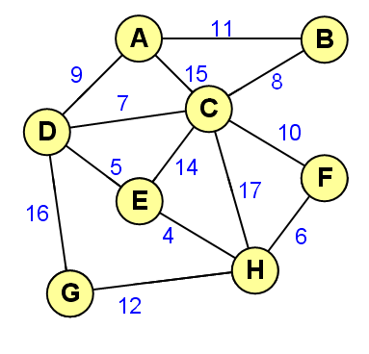
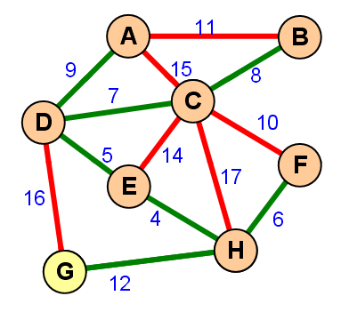
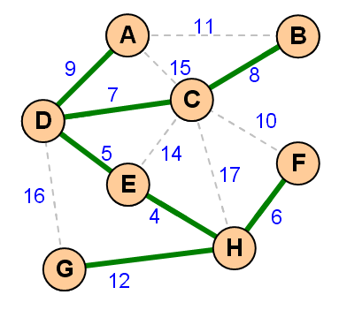
EXAMPLE MST PROBLEM

Slide 56
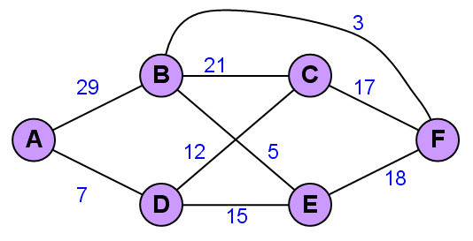
SHORTEST PATH
In a graph each edge has weight, the shortest path between 2 nodes can be search by Greedy Method.
Suppose we want to find the shortest path (shortest path) from node A to node F, how is it calculated with the method Greedy?

Slide 57
Dijkstra’s Algorithm
Dijkstra's algorithm:
initSSSP
while the priority queue PQ is not empty
for each neighbor v of u = PQ.front()
relax(u, v, w(u, v)) + update PQ

Slide 58
Dijkstra’s Algorithm
Dijkstra's algorithm:
Explanation :
Select the source node (initial node)
Define N as empty set
Label the initial node with 0, and insert it into N
Repeat steps 5 to 7 until the destination node is in N or there are no mode labelled nodes in N.
Consider each node that is not in N and is connected by an edge from the newly inserted node.
(a) If the node that is not in N has no label then SET the label of the node = the label of the newly inserted node + the length of the edge
(b) Else if the node that is not in N was already labelled, then SET its new
label = minimum (label of newly inserted vertex + length of edge, old label)
Pick a node not in N that has the smallest label assigned to it and add it to N.

Slide 59
Dijkstra’s Algorithm
Simulation :
Find the shortest path from node A to F using Dikjstra’s Algorithm!
B
3
D
2
1
A
5
2
1
4
C
E
2
4
3
1
F

Slide 60
Dijkstra’s Algorithm
Simulation :
Answer : the shortest path is A – C – D – E – F with 4 cost or A – C – F with 4 cost or A – F with 4 cost.
B
3
D
2
1
A
5
2
1
4
C
E
2
4
3
1
F

Slide 61
Dijkstra’s Algorithm
Solution Table :
MARK | A | B | C | D | E | F
NULL | ~ | ~ | ~ | ~ | ~ | ~
A | 0 | ~ | ~ | ~ | ~ | ~
C | 0 | MIN(~, 0 + 2) 2 | MIN (~, 0 + 1) 1 | ~ | ~ | MIN(~, 0 + 4) 4
B | 0 | MIN(2, 1 + 5) 2 | 1 | MIN(~, 1 + 1) 2 | MIN(~, 1 + 2) 3 | MIN(4, 1 + 3) 4
D | 0 | 2 | 1 | MIN(2, 2 + 3) 2 | MIN(3, 2 + 4) 3 | 4
E | 0 | 2 | 1 | 2 | MIN(3, 2 + 2) 3 | 4
F | 0 | 2 | 1 | 2 | 3 | MIN(4, 3 + 1) 4

Slide 62
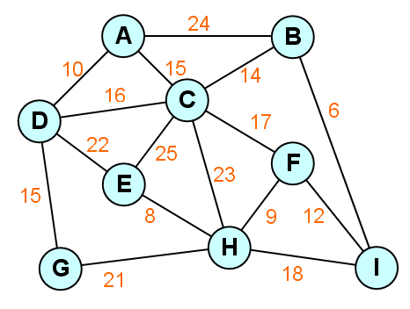
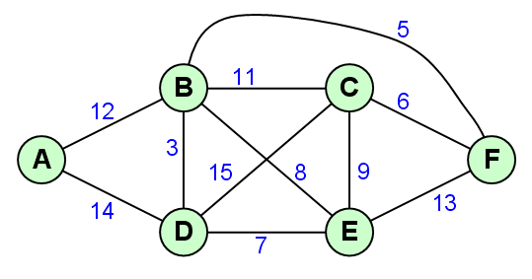
EXERCISE
Create a Minimum Spanning Tree using Prim-Dijkstra algorithm and Kruskal algorithm.
Determine Shortest Path from node A to node F using Greedy Method!
Discuss: why Greedy Method violate to get the best solution!

Slide 63
REVIEW
SOLUTION OF PROBLEMS
PROBLEM SOLVING TECHNIQUES
UNIVERSAL SOLUTION
KNAPSACK PROBLEM
VARIATION OF KNAPSACK PROBLEM
CALCULATION FEASIBLE SOLUTION
UNBOUNDED KNAPSACK PROBLEM (1)
UNBOUNDED KNAPSACK PROBLEM (2)
FRACTIONAL KNAPSACK PROBLEM
JOB SEQUENCING WITH DEADLINES

Slide 64
Q & A

Slide 65
References
S. Sridhar. 2014. Design and Analysis of Algorithms, 1/e. Oxford University Press. India. Chapter 11
Ellis Horowitz,Sanguthevar Rajasekaran,Sartaj Sahni. 1998. Computer algorithms/C++. 1STBL. New York. Chapter 4
The Greedy Method https://www.seas.gwu.edu/~ayoussef/cs6212/greedy.html
Disjoint Set Data Structure
https://www.topcoder.com/community/data-science/data-science-tutorials/disjoint-set-data-structures/

Slide 66
THANK YOU

